Slide 1



ALM con Visual Studio Team Services… e non solo
Riccardo Cappello – Operative Manager @ ALTEN Italia
@rcappello | Microsoft Azure MVP | Intel Software Innovator

Slide 2
Geodistribuzione del TEAM
Milano
Brescia
Contoso TEAM
Taggia
Firenze
Cristian (Brescia)
Marco L. (Firenze)
Marco M. (Taggia)
Riccardo (Firenze)
Marco DP (Viareggio)
Marta & Lucrezia (Milano)
Viareggio
Notes:
2

Slide 3
Gli obiettivi
Coordinare il team
Gestione iniziale del VSTS
Creazione Features, User Stories e Task iniziali
Fare aprire i task dal team
Fare associare i task ai checkin
Rilasciare le API (in parte grazie a Cristian)
Rilasciare in Q/A e Produzione il Front-End
Rilasciare in Q/A e Produzione le Apps

Slide 4
DEMO – Organizzazione VSTS
Notes:
Organizzazione VSTS
Progetto Agile
Repo Git
Branches
Branches progetti

Slide 5








Contoso Spare Parts
Development
Q/A
Contoso Spare Parts API Mock
Back-end
Front-end
Mobile Apps
Production
Contoso Spare Parts API
IoT
Analisi

Slide 6
DEMO – Distribuzione API

Slide 7

Contoso Spare Parts
Development
Q/A
Contoso Spare Parts API Mock
Back-end
Contoso Spare Parts DEV
Front-end
Mobile Apps
Production
Contoso Spare Parts API
IoT
Contoso Spare Parts
Analisi

Slide 8
DEMO – Distribuzione Front-End

Slide 9



Contoso Spare Parts
Development
Q/A
Contoso Spare Parts API Mock
Back-end
Contoso Spare Parts DEV
Play Store Alpha
Front-end
TestFlight
Mobile Apps
Production
Contoso Spare Parts API
IoT
Contoso Spare Parts
Analisi
Play Store
App Store
Notes:
Fare Task per Marco
Accettare pull request
Build Android
Release Android
-
Build iOS
Relese iOS

Slide 10
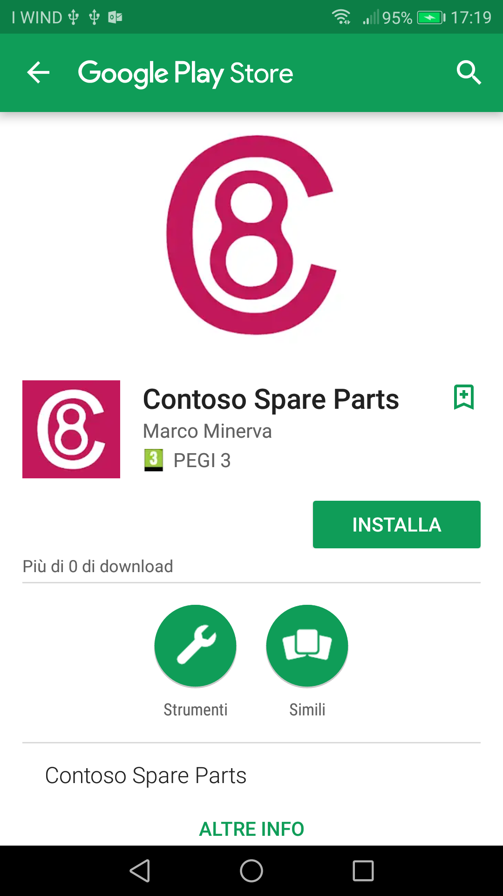
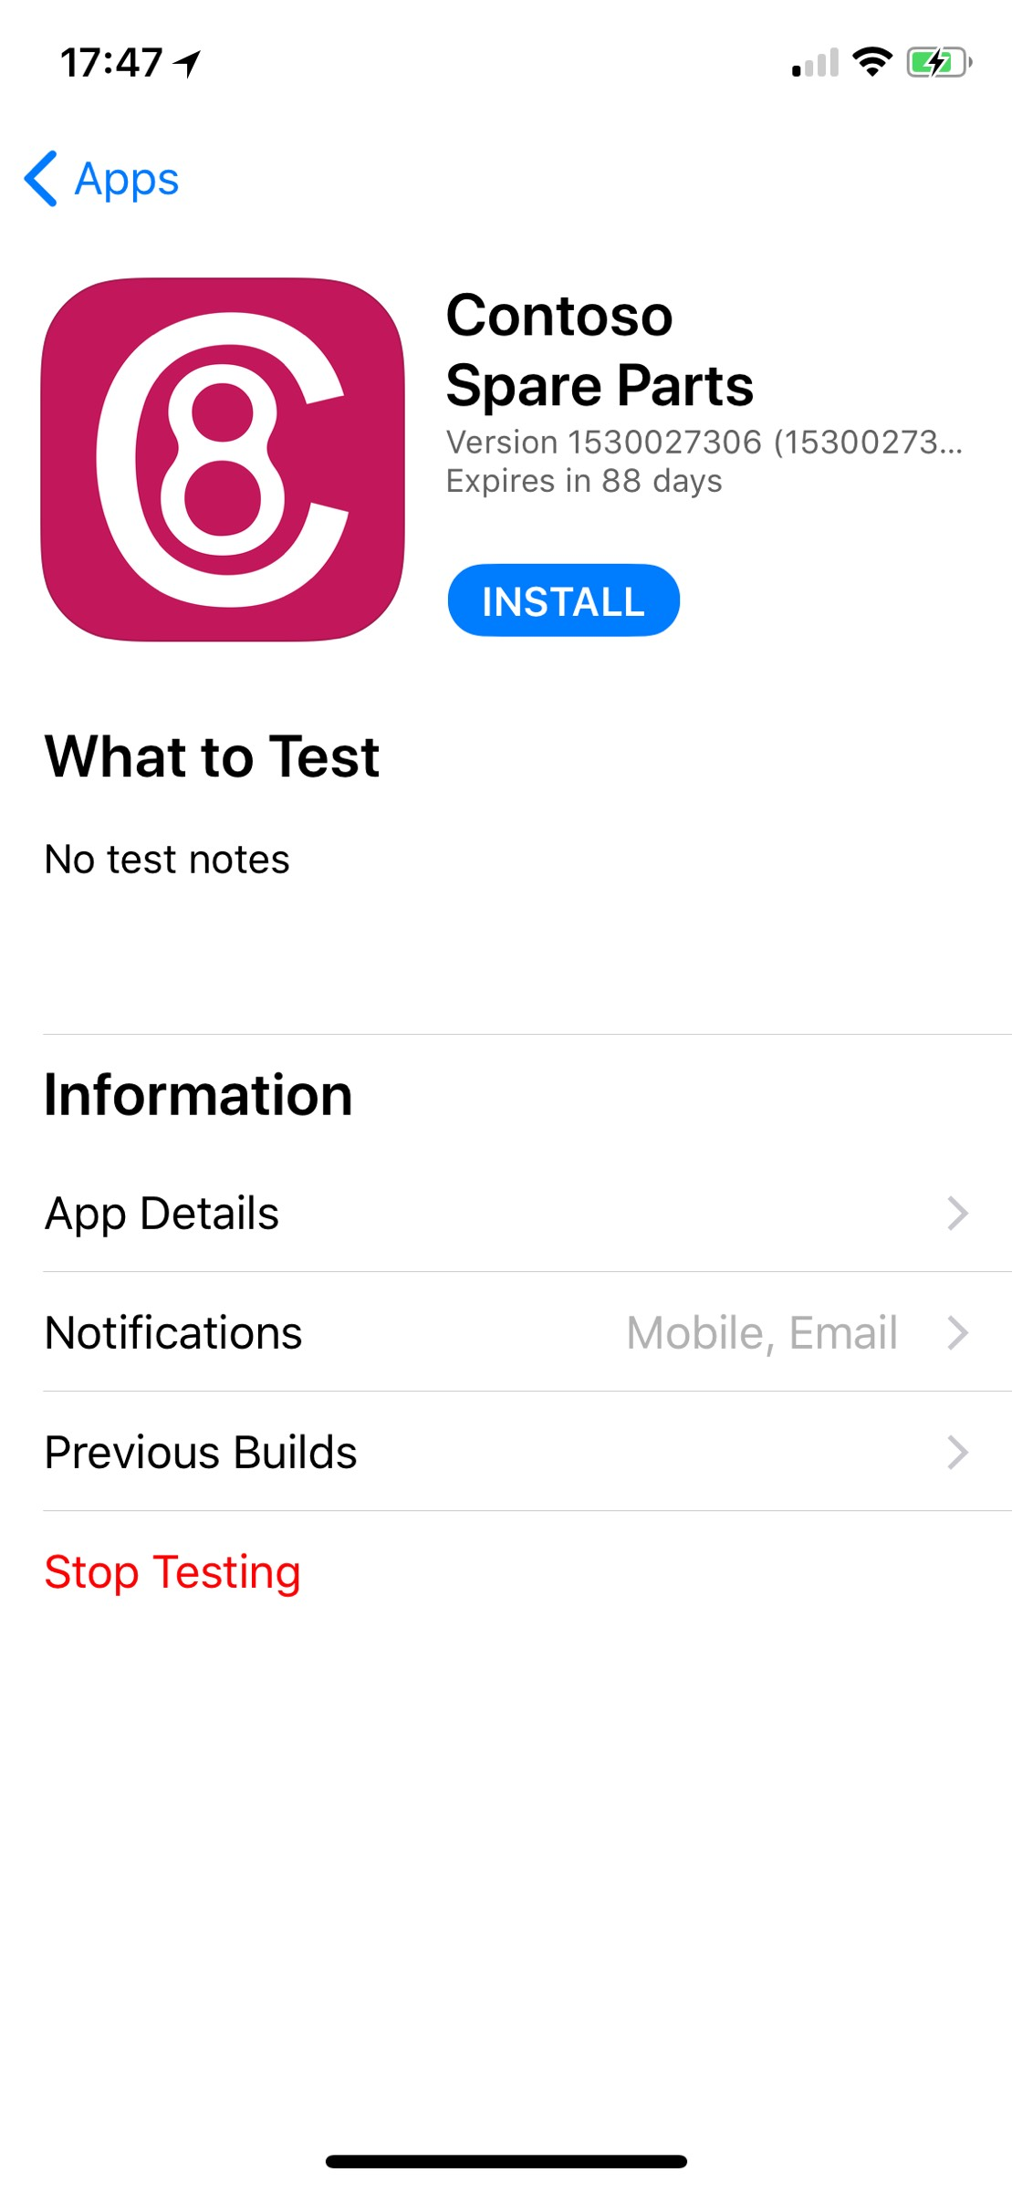

Slide 11
DEMO – Distribuzione Apps

Slide 12
Riferimenti
https://visualstudio.microsoft.com/team-services/
https://appcenter.ms
https://docs.microsoft.com/en-us/appcenter/
https://medium.com/@flu.lund/automated-angular-unit-testing-on-visual-studio-team-services-22c03497265c

Slide 13







Where are the instructions? https://aka.ms/ms-docs
Docs.microsoft.com is new the platform hosting Microsoft technical documentation. Content is Open Source(*), Hosted on GitHub, Community-enabled + in your own language!
Help the Community improve Docs, and grow your reputation online!!
Discover how here https://aka.ms/intldocs
Do you like Open Source? https://aka.ms/msossloc
VS Code
SQL on Linux
SQL Ops Studio
in your language,
today!
Team Explorer Everywhere
… and more!

Slide 14
https://github.com/AltenITALIA/ContosoSpareParts

